Slide 1

CAPO and Time to Clinical Stability

Slide 2
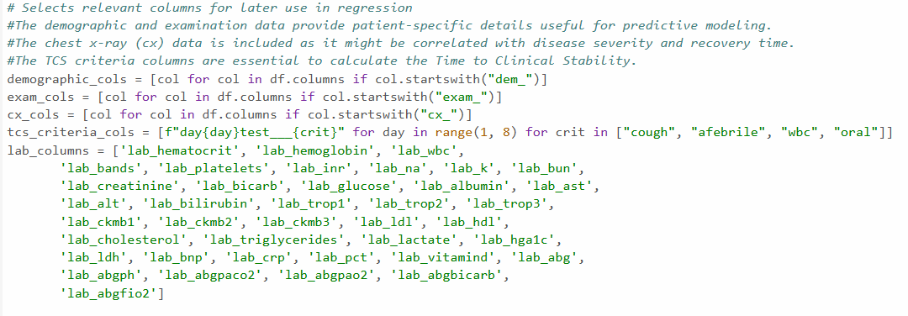
Data Selection

Slide 3
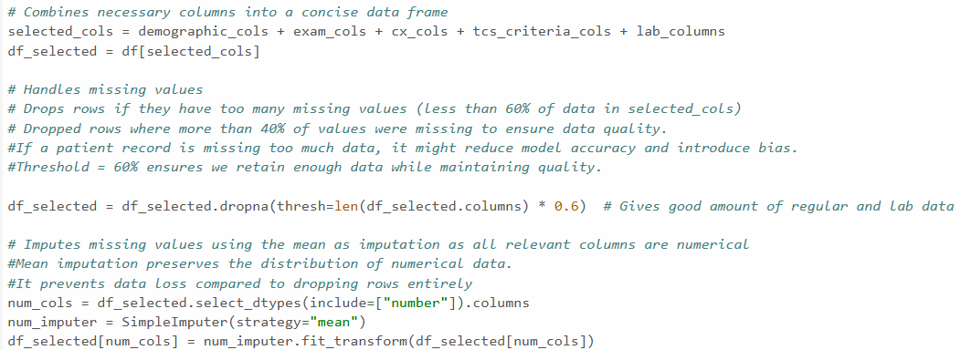
Data Processing

Slide 4
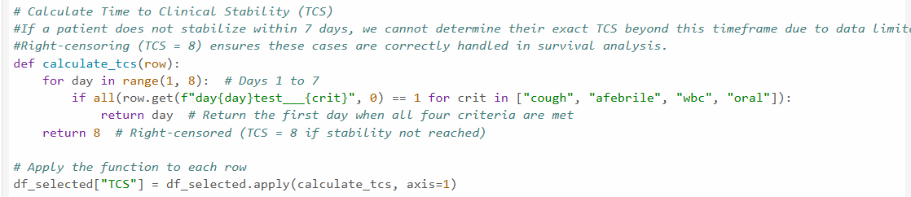
Calculating Time to Clinical Stability
Only concerned with patients whose TCS is </= 7 days
Right-censors data at 8 days

Slide 5
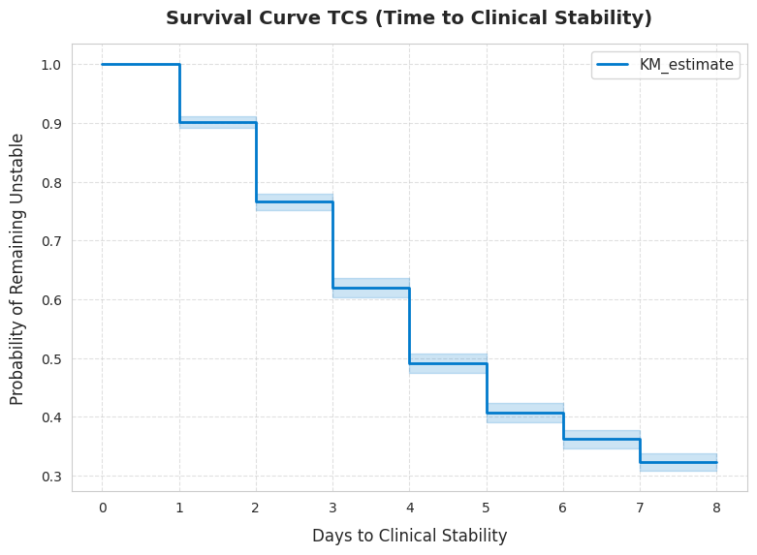
Survival Curve of TCS Outcomes

Slide 6
Regression Model Goal
Uses linear regression model from Sklearn
Predict time to clinical stability
Evaluate the model using R² Value

Slide 7
Regression Model Outcomes
R² Value
0.053
Categories used
Demographic
Examination
Chest x-ray data

Slide 8

Logistic Regression Models Goals
Create two classification variables
Early TCS (TCS < 4)/ Late TCS (TCS >= 4)
Stable/ Not Stable (TCS > 8)
Evaluate the model using R² Value

Slide 9

Logistic Regression Models Outcomes
R² values
TCS Early/ TCS Late: 1.00
Stable/ Not Stable: -2.27
Categories used
Same as linear regression

Slide 10

Logistic Regression Models Including Lab Data
R² values
TCS Early/ TCS Late: 0.98
Stable/ Not Stable: -2.26
Categories used
Same as previous categories
Lab data included

Slide 11
Conclusion
Knowing if patients would have an early or late TCS is reliable
If the patients will become stable or not stable is unreliable
Regression Model
Performed poorly
Logistic Regression Models
Early TCS/ Late TCS consistently performed well
Stable/ Not Stable was extremely inconsistent

